Slide 1
JHM Institutional Review Board (IRB)
SOM Orthopedic Surgery Trainee Bootcamp
Presented by: Jessica Jones, JHM IRB Training Manger, jjone243@jh.edu
Tammy Bixby, IRB Exempt/Expedited Analyst, tbixby1@jh.edu

Slide 2
Agenda
IRB Overview
How to effectively work with the IRB
  eIRB: A brief overview
Common application pitfalls & how to avoid them
Resources:
  Training, Office Hours
  JHMI IRB Request a Consult Service
Questions

Slide 3
IRB Overview

Slide 4

Fundamental Goals/Obligations
JHM IRBs are responsible for protecting the rights and welfare of the human participants involved in research conducted by faculty and staff at the Institutions.
Protecting the rights and welfare of human participants:
Voluntary participation
Informed consent
An acceptable risk/benefit ratio
Minimizing risk to the extent possible
Increased attention if vulnerable populations involved: children, prisoners, pregnant individuals, cognitive impairment, etc.
Appropriate amount of remuneration (re: potential for undue influence)
Special situations: Research in the emergency setting when consent isn’t possible

Slide 5
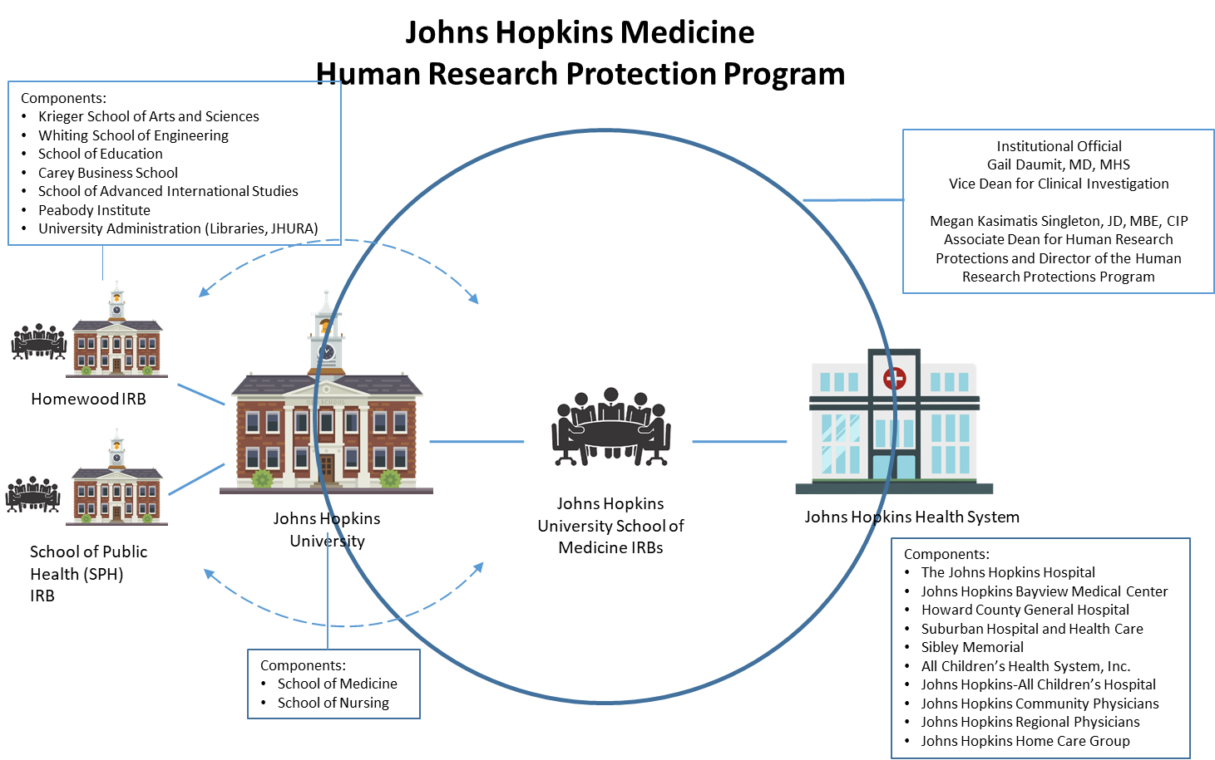
Overview

Slide 6
Overview, continued
Meeting composition & frequency:
8 IRBs (1,2,3,5,6,X, Executive Committee (EC) and JHM ACH)
Each IRB meets weekly except JHM ACH IRB and EC
IRBs meet for 2 hours; review 20 plus applications/week including:
  New Applications
  Change in Research
  Continuing Review
  Protocol Events
Agendas are finalized 7 to 10 days prior to the meeting

Slide 7
IRB Review Types:
Convened: research that is greater than minimal risk or does not fall within one of the designated categories for minimal risk research under the regulations.
Expedited: must present no more than minimal risk as defined by DHHS/FDA regulations; eligible for review by a single Board reviewer.
    Note: Expedited does not mean “fast tracked”
Exempt: Includes some research done in educational settings, observations of public behavior, surveys, most chart reviews, use of publicly available data, or taste and food quality evaluation. This category does not apply to FDA regulated research
    Note: Exempt research is still Human Subjects Research and does not mean IRB review isn't required
Not Human Subjects Research (NHSR)/ Quality Improvement (QI/QA):
  Research does not involve identifiable human subjects/their data (NHSR)
  Data collection and analysis activities in the health services area that are not intended for general scientific knowledge, but rather are used as a management tool to improve the provision of services to a specific health care population (QI/QA)

Slide 8
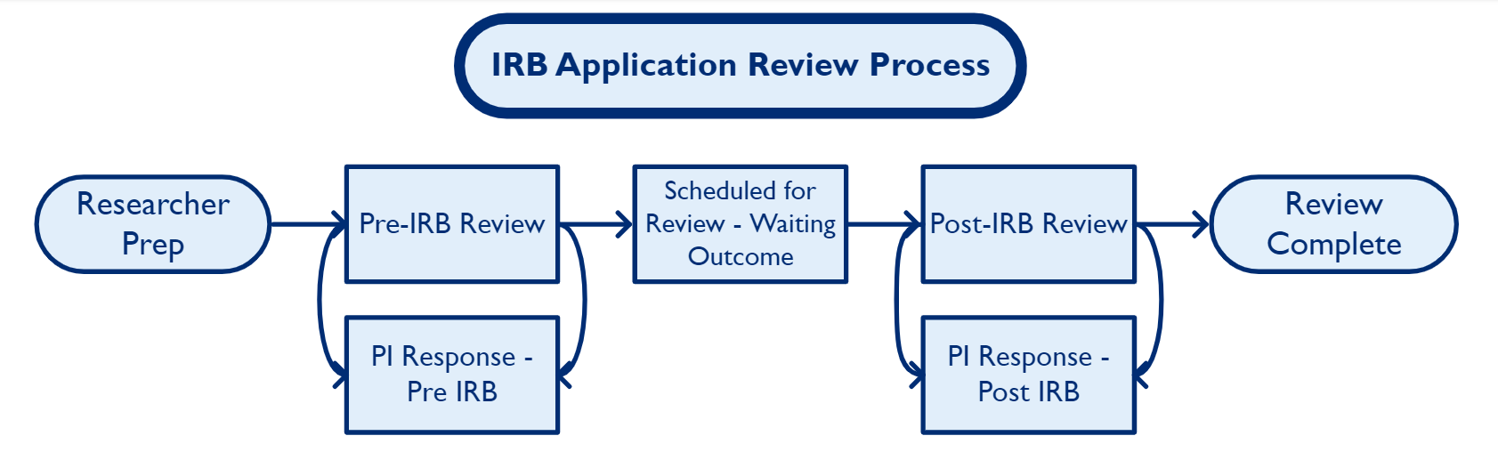
Application Process:

Slide 9
Working with the IRB

Slide 10
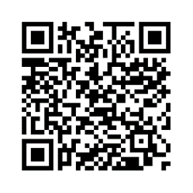

Communication
OHSR is fully remote however, available in several ways:
Contact Us
Page
Includes all staff's phone, email and MS Teams link
Request a Consult
Help Desk
jhmeirb@jhmi.edu
410-502-2092
Ancillary
Committees
Department & Ancillary Reviews - Hopkins Medicine

Slide 11
OHSR Staff:
Pre-Team IRB Coordinator/Analyst - For questions regarding when an application will be scheduled for review, issues returned in a pre-review note and placement of documents in the application.
Post Team IRB Coordinator/Analyst - For questions regarding the outcome of a study, requesting an extension to respond, stamped documents, questions about tabled issues or questions about your outcome letter.
Consent Form Specialists - For questions about consent forms, the consenting process or types of consent please contact one of the consent form specialists.
Compliance Associates - For questions about regulatory issues, compliance with federal, state and local policies, general compliance issues, protocol events or noncompliance.
Reliance Team - For questions about requesting a reliance agreement, single IRBs for a multi-center study, or relying on a commercial IRB please contact the IRB Reliance Program.

Slide 12
eIRB – A brief overview

Slide 13
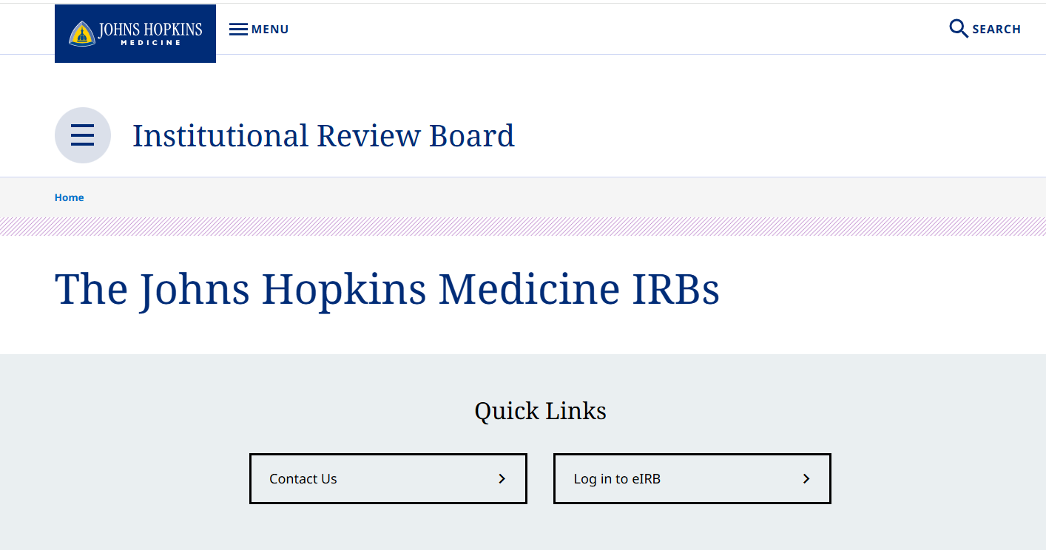
Logging into eIRB www.hopkinsmedicine.org/institutional-review-board

Slide 14
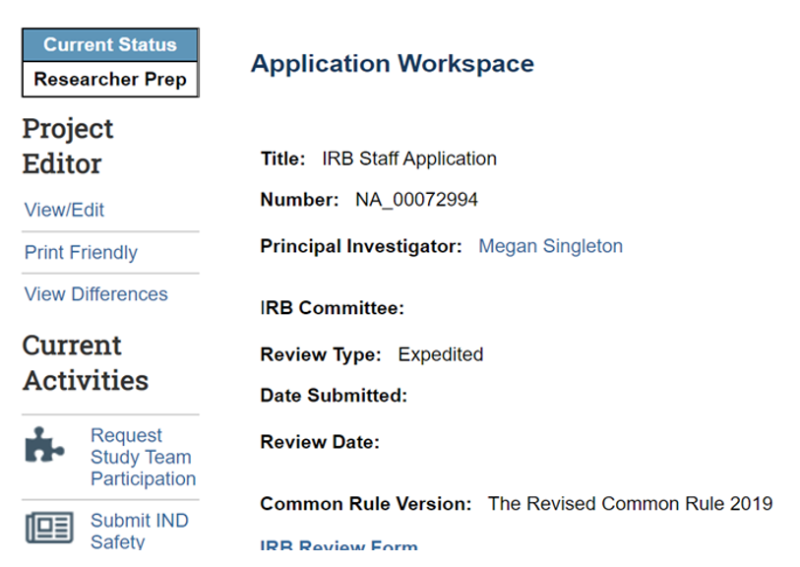
eIRB, continued:
IRB Committee assigned is who you want to contact about a specific study
Date of the review will be located on the application workspace page once scheduled.
30 days to respond
Can request extensions
Sign up for eIRB101 Training for more information on how to navigate the eIRB system! Training is held the 3rd Friday of every month at 10am. Click here to register.

Slide 15
Common pitfalls &
how to avoid them

Slide 16
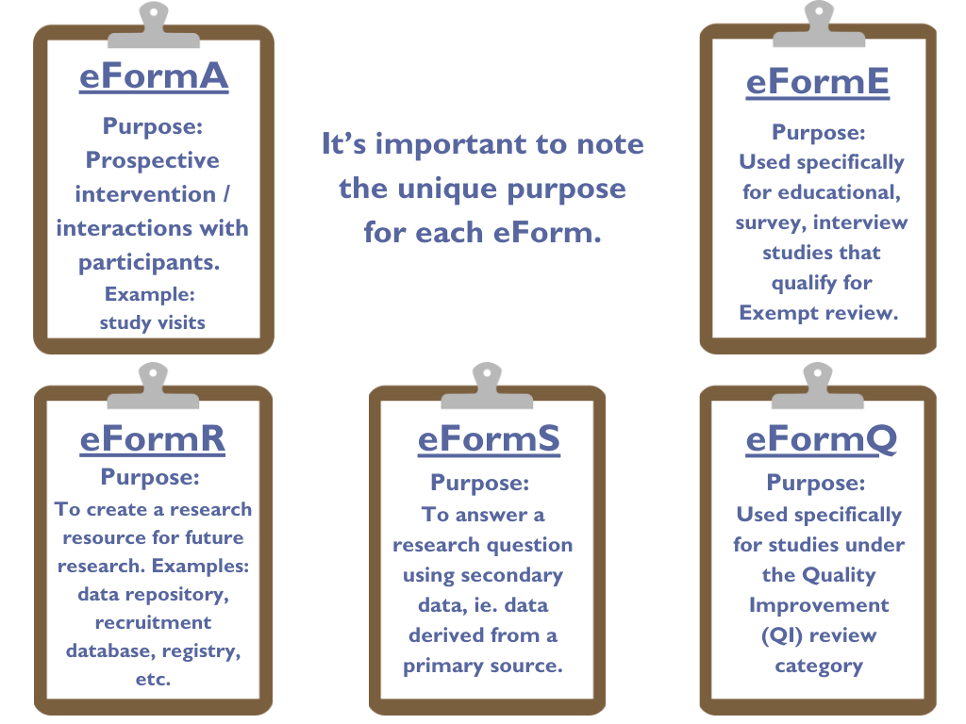
Protocols:
IRB templates/forms must be downloaded from within the eIRB application/IRB site. Use the Help Link icon to download the latest versions of templates/forms.

Slide 17

Best Practices:
Documents
Data Management
Training
Review our Forms page to confirm the correct templates are being used.
Open all documents once uploaded to confirm the correct documents were uploaded and is not password protected.
Make sure clean and tracked versions are uploaded when appropriate. See guide for more details.
SAFE Desktop, SAFER, SAFESTOR, and Discover are best for data storage and analysis.
Qualtrics and REDCap is the approved method for research surveys.
See Research IT click here for more info on SAFE.
Qualtrics guidance is linked here.
Additional information on REDCap can be found here. ​​
Initial IRB Compliance Training Bundle
Should be taken if you have never taken JHM IRB Compliance training
Principal Investigator and Study Team Member Recertification
Must be taken every 3 years after completion of your initial HSR Training.
SPH and Homewood have their own IRB training requirements

Slide 18
Ways to streamline time to approval:
See the link for Department and Ancillary reviews that may be required:
  Department & Ancillary Reviews
    Includes Conflict of Interest (COI), Biospecimens Transfer Committee (BTC), the Data Trust and many more!
    You can reach out to reviewers to check on the status!
Employee/student recruitment: See guidance
Ensure all study team members have completed training
Stacking and formatting documents in eIRB, instructional video: click here
If you're unsure how to respond to a review comment, reach out to the primary reviewer listed in the Board's letter
For helpful step-by-step guides, please see eIRB Tutorials: click here
For complicated projects, reach out to IRB ahead of time
  Use our Request a Consult Service (linked at the end of these slides)!

Slide 19
Pre-Review Errors
A pre-review occurs prior to the application being scheduled for review by the IRB. We try not to return more than twice in a pre-review but there are exceptions to every rule.
  Providing tracked change version of new documents
  Information inconsistent between protocol, consent form, recruitment material and application sections.
  Not disclosing conflicts of interest to the Office of Outside Interests
  Not reviewing and accepting the PRA
  Not answering all applicable questions

Slide 20
Post-Review Errors
Post meeting errors occur after the IRB or a single reviewer has reviewed your application and tabled it with issues or approved with administrative changes.
  Not identifying additional changes being proposed outside of what the Board has requested
  Not reading the entire reviewer note and submitting without addressing all concerns
  Not responding to the reviewer note and trying to submit.
  Not providing tracked document
  Making additional changes when the outcome was “Approved with Administrative Changes”

Slide 21
Study Team Member Errors
One of the most frequent issues we encounter is related to study team members. Training and document updates can all prolong the review of a study if not done properly.
  Missing Initial IRB Compliance training and/or recertification compliance training certificates/dates
  Changing the PI/Study Team Member but not revising documents/sections to reflect these changes

Slide 22
Consent Form Errors
Written consent and waiver of documentation of consent involve several necessary elements and various additional factors to take into account. Navigating these forms can be challenging if you are unfamiliar with what needs to be included and how to incorporate it accurately.
  Not including or removing required language (e.g., Conflict of Interest, Radiation, Certificate of Confidentiality)
  It’s important to use the last approved WORD version of the Hopkins Informed Consent document when making changes. Please avoid converting the PDF copies of stamped consent documents to a Word document to create tracked versions. Inconsistent formatting makes it difficult to distinguish the changes from the last approved version in such cases.

Slide 23
Other considerations to keep in mind:
Most new applications are returned for corrections and/or clarification at least once.
Don’t hesitate to reach out with any questions!
Scheduling an eIRB application action can take up to 3-6 weeks depending on volume, time of year, staffing and complexity of research project.
Average scheduling time is 2-4 weeks from the final PI submission date.

Slide 24
Resources

Slide 25

Resources:
Contact us: find staff phone numbers, emails & Teams Chat links
Forms: protocol templates & other documents
Tutorials: includes workflows, training how-to’s & video tutorials
Department & Ancillary Reviews: list of department & ancillary reviewers and their contact info
Training Requirements: IRB compliance & recertification training
Research IT: Core Services for Research IT will focus on infrastructure, support & service connectivity
Institute for Clinical & Translational Research (ICTR) Services & Resources: The ICTR offers many different services and assists researchers to develop and produce high quality research, in an efficient way
Recruitment Innovation Unit (RIU) Consult: The Recruitment Innovation Unit (RIU) at the Johns Hopkins Institute for Clinical and Translational Research supports research teams in both technology-driven & community engaged recruitment strategies and outreach.

Slide 26

IRB Office Hours
JHM IRB Office Hours are held each month on a variety of topics in order to learn about research related topics in relation to the IRB. Our next session be held on October 27th at 1pm and will focus on High Risk Review Committee. Register here
Links to a few of our past presentation slides:
  5.14.24: Common IRB Application Errors
  9.20.24: Quality Improvement (QI) vs. Human Subjects Research
  4.25.25: Consent Form_Tips for developing consent forms
  5.16.25: Considerations for data sharing

Slide 27
Educational Opportunities:
IRB Basics course
Teaches the history of IRBs and provides researchers with the basics for conducting human subjects research at JHM., the meaning of IRB review types and the JHM IRB review process. Click here to register.
eIRB101 Training:
Sign up for eIRB101 Training for more information on how to navigate the eIRB system! Training is held the 3rd Friday of every month at 10am. Click here to register.

Slide 28
JHM IRB Request a Consult Service
Need help navigating the IRB review process? Use the QR code or visit the IRB website to request a consult and be matched with IRB staff who will address your needs.
Sample topics we can help with:
  Protocol planning
  Determining IRB review type & forms
  IRB regulations and policies
  Recruitment & consent
  Responding to IRB review
Consult requests will receive a response within 24 hours – please reach out!
Consult requests will receive a response within 24 hours – please reach out!

Slide 29
Questions?
Thank you!

