Slide 1


Bootcamp Writing 2:
Journal Selection, Author Order, & Review Stages
Rachel Walden, MS, ELS
Johns Hopkins School of Medicine
Dept. of Orthopaedic Surgery
October 7, 2025

Slide 2
Upcoming Welch sessions
Literature searching & reviews
  Oct 9: Literature Databases Beyond PubMed
  Oct 23: Intro to Covidence
Reference management
  Oct 13: Refworks Basics
  Oct 24: EndNote Desktop: an Intro
Data handling
  Nov 3: Protecting Human Subject Data Privacy I
  Nov 4: Protecting Human Subject Data Privacy II

Slide 3
Today’s objectives
Prevent authorship disputes
2
Choose an appropriate journal for your work
1
Describe the stages of manuscript review
3
©2025 Rachel Walden

Slide 4
Selecting a journal
Beyond impact factor

Slide 5
Step 1: Avoid predatory journals
Is it indexed in PubMed/Scopus? ✓
Does it have a legit editorial board? ︎✓
Are any fees clearly described? ✓
Is there an actual editorial office you can contact? ✓
Did they send you a nice invitation? ✘

Slide 6

Dear Esteemed Researcher,
I hope you are doing well.
We are impressed by your research and invite you to submit a manuscript to Annals of Case Reports.
We are accepting all types of manuscripts like Case Reports, Case Series, Clinical Images, Case Studies, Clinical Cases, Research Articles, etc. for our upcoming issue.
Submission Deadline: October 11 ,2025.
NOTE : If the article is ready, kindly submit it to this mail. Each article will undergo a fast-track review process and publish within 3-6 days.
Awaiting your submission.
With Regards,
Lavinia
Editorial Assistant

Slide 7
Step 2: Create an initial list of journals
Try JANE (jane.biosemantics.org)
Search your keywords on PubMed to find similar articles
Consult with your colleagues
Ask a librarian
Ask Rachel or Denise

Slide 8
Step 3: Shorten the list
Step 3: Shorten the list
Who reads the journal?
Do they accept your article type?
Do they have restrictions on word limit, number of tables, figures, references, number of authors?
Have they published on your topic recently?
How long does it take to publish there?
What does it cost? (to submit? to publish?)
Do you need an open access license?
What is the Impact Factor?

Slide 9
Journal selection
What is Impact Factor?
Mean number of times the articles published by the journal in 2 years were cited in the year that followed
Not a measure of quality
Example
500 citable articles published by Journal A in 2021 & 2022
Those articles were cited 1000 times in 2023
1000 / 500 = impact factor of 2.0 for Journal A in 2023

Slide 10
Step 4: Select your first-choice journal
Weighing all the factors, make your top choice
Be sure your coauthors agree
Ensure the senior author has funds to cover any associated costs
Have a back-up plan

Slide 11
Journals Being Considered | In PubMed? | Article Type ok? | No. of Similar Articles in Past 3 y | Readership (Who?) | Impact Factor | Costs

Slide 12
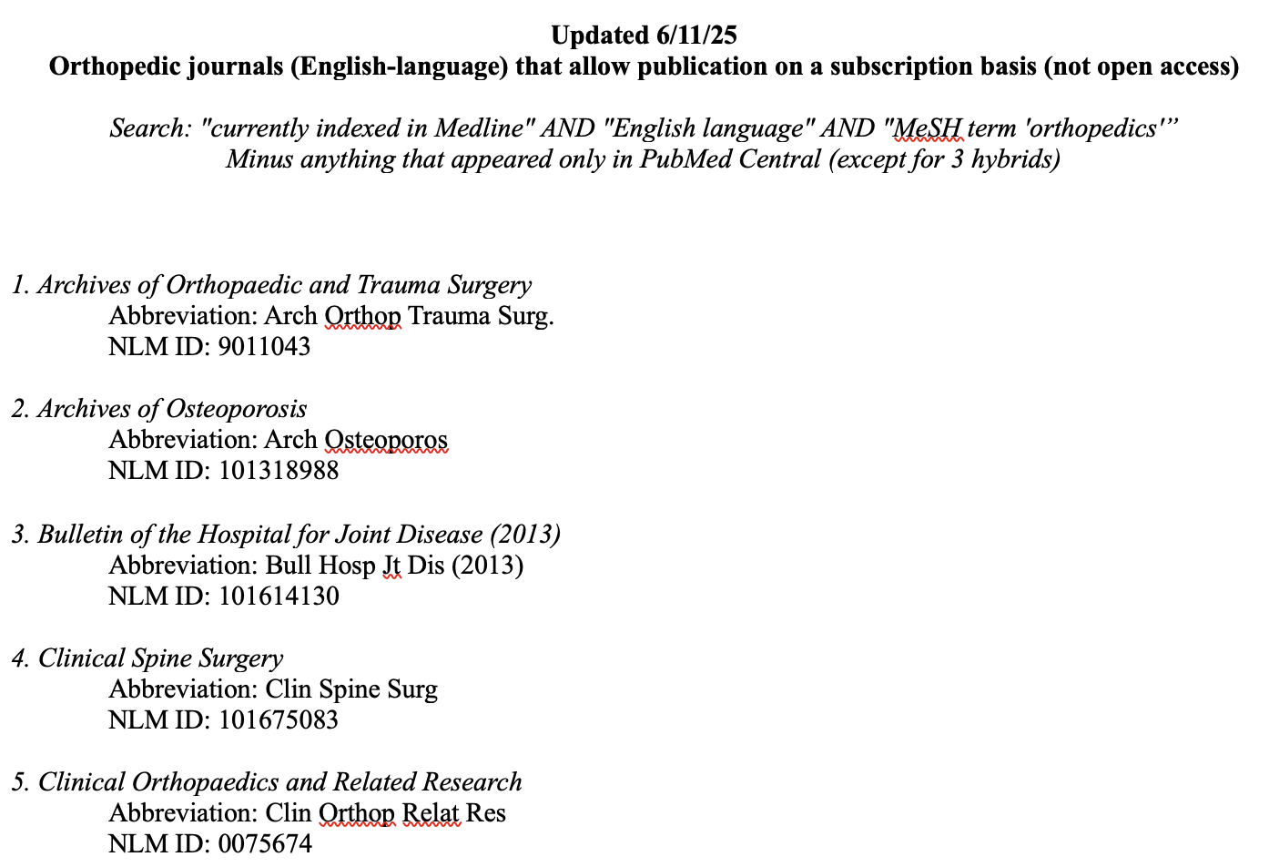

Slide 13
Preventing authorship disputes
And getting the credit you deserve

Slide 14

Establishing authorship
Step 1: Determine who qualifies
  1. Contributed substantially to conception & design, acquisition of data, or analysis/interpretation of data
  AND
  2. Drafted article or revised for important intellectual content
  AND
  3. Participated sufficiently in the work to take public responsibility for appropriate portions of the content
  AND
  4. Approved the version to be published

Slide 15
Tasks that don’t qualify
Acquiring funding
Providing material resources
Collecting data on a fee-for-service basis
Supervising the research group
Making minor revisions to the manuscript

Slide 16
Establishing authorship
For those who do not qualify for authorship
You can include them in the acknowledgments
Be sure to obtain their permission first

Slide 17
Step 2: Determine author order
Biomedical publishing conventions
  First author is the person who drafted the manuscript
  Last author is the senior team member
Middle authors: use a grid to order according to level of contributions

Slide 18
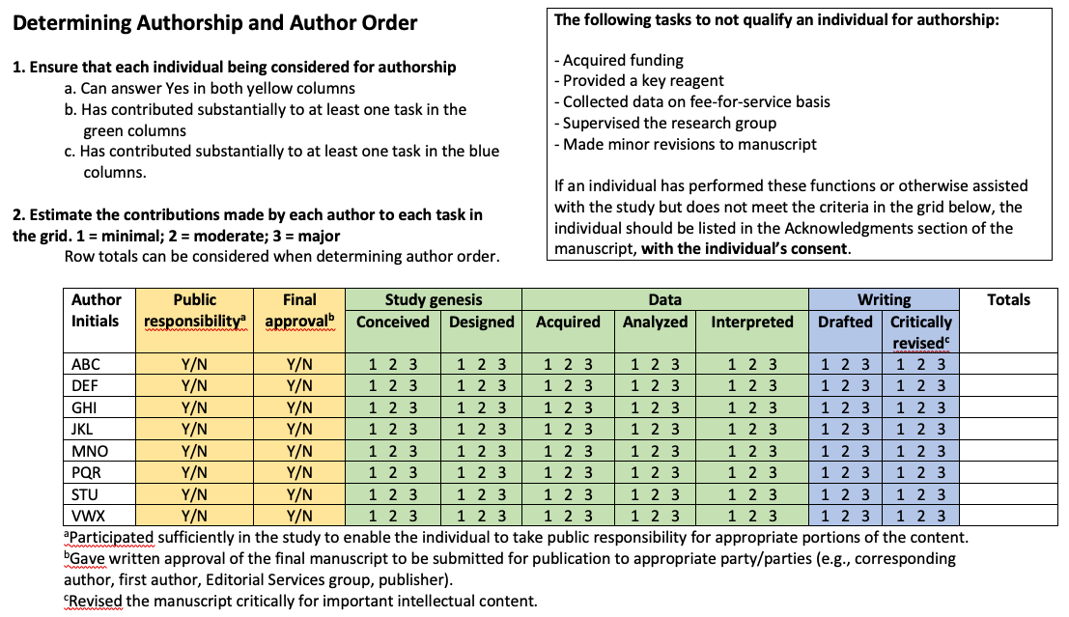

Slide 19
Tips
There is only one first author
Some journals don’t allow the statement of joint first-authorship
Decide on a first author at the start
If 2 authors are contributing equally, suggest alternating first authorship from project to project
Be sure all authors will be available to approve the final version
Avoid making author changes (especially subtractions) after submission; they will require a signature from the authors

Slide 20
Stages of manuscript review
What to expect when you hit “submit”

Slide 21

Internal review
Within your institution
You (and your coauthors) draft the manuscript
Senior author provides input & you incorporate
Editorial services reviews & edits
All authors approve final version

Slide 22
External review process
Editor reads your cover letter
Reject
Assign to senior editor
Reject
Assign to assoc. editor
Reject
Assign to peer reviewers
Reject
Revise
Accept
Reject
Accept

Slide 23
Peer review
Most common types of peer review
Single-blind (reviewers know authors)
Double-blind (reviewers & authors both blinded)
Open (identities known)

Slide 24

Notes on the peer review process
It can be lengthy; often >2 months for the first review
If journal requests revisions, you will have a deadline
Senior author must approve revisions & responses to reviewers
Occasionally, paper is subject to a second round of review
Some papers are also reviewed by a specialty editor (e.g., biostats)

Slide 25
Post-acceptance
Journal copyedits the manuscript
  Ensures it confirms to “house style”
  Catches anything the authors have missed
Typesetter lays out the pages
  All elements are rendered in standard style
  Tables, figures, text, references formatted
You review a proof
  Check carefully for errors
  Typesetting can introduce mistakes
  This is your last chance to make adjustments
  Avoid making any substantive changes
Journal incorporates any proof corrections

Slide 26


Slide 27
Questions for me?
rachelwalden@jhu.edu

