Slide 1
Data Acquisition and Management
Secure and Ethical Data Use
Richard L. Skolasky, Sc.D.
Lewis Cass Spencer Professor and Vice Chair of Research
Department of Orthopaedic Surgery
Johns Hopkins University School of Medicine

Slide 2
Overview
Data Acquisition and Management
  General – data lifecycle
  Data SOPs for every research project
Secure and Ethical Data Use
Data Sharing and the IRB

Slide 3
Objectives
Communicate plans for data lifecycle and provenance from creation to scholarship, sharing, and retention
Identify data security practices fundamental to our goals for rigorous research, equity, and privacy

Slide 4
Researchers' Responsibilities
Be able to find the data and trace its history
  Data not retained
  Challenge of changes in location, personnel
Organize the data
  Poorly indexed
  Duplicated, poorly-annotated changes
Link data with results, tables, & figures
  No idea which data were used

Slide 5
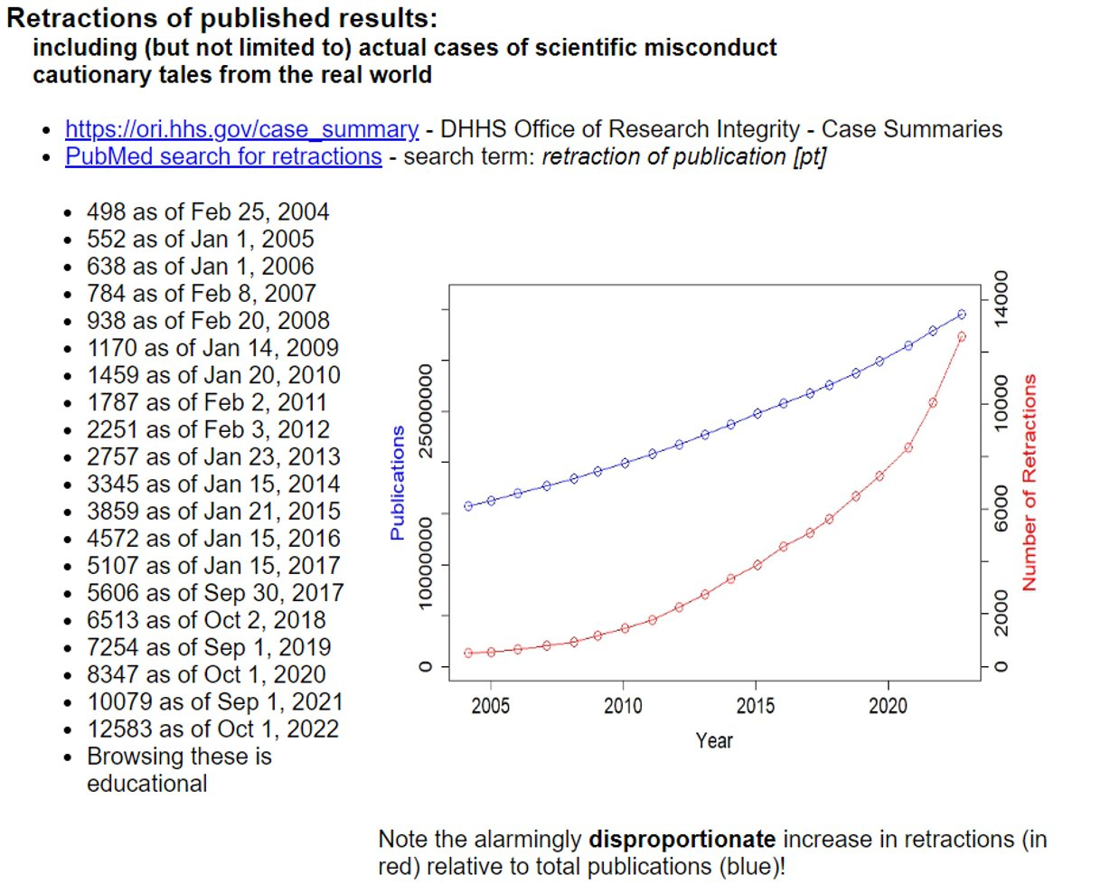
Retraction are on the rise!

Slide 6
Data handling practices

Slide 7
Types of Data
PHI
PII
Any information about an individual's health, healthcare, or payment for healthcare that can be linked to their identity
Name
  Address
  Dates (birth, admission, discharge)
Any data that can be used to directly or indirectly identify an individual, and its sensitivity can vary, with some data requiring higher levels of protection
  Name
  Address
  Dates
  Biometric data
  Driver's license number
PII
PHI

Slide 8
Computers
Windows 10/11 and MacOS are supported
  Only JH-owned and managed computers for JH data handling
  Don’t use your own for storage/analysis – you can access JH Cloud/SAFE desktop from any Chrome browser, even a home/personal computer

Slide 9
Electronic messaging
Use only Hopkins email for Hopkins work
  You can create email alias at https://my.jh.edu/
Hopkins email
  No forwarding to other servers (e.g. Gmail)
  Minimize PHI in body/attachments
  Zero PHI in subject line
  “[secure]” in Subject to help protect PHI/PII
  Avoid long “To:” lists
    Use bcc, listserv (lists.johnshopkins.edu), or distribution list
  Recognize phishing and spear-phishing

Slide 10
Manage all JH work data files on JH network folders
  JHOneDrive, JHTeams, JH SAFE "S:" drive, "H:" drive, JHU REDCap, or similar;
Minimize storing data on the hard drive of your JH-owned & managed computer/laptop
  Avoid* storing JH data on:
    USB drive
    DropBox, Box, Google Drive, iCloud, etc

Slide 11
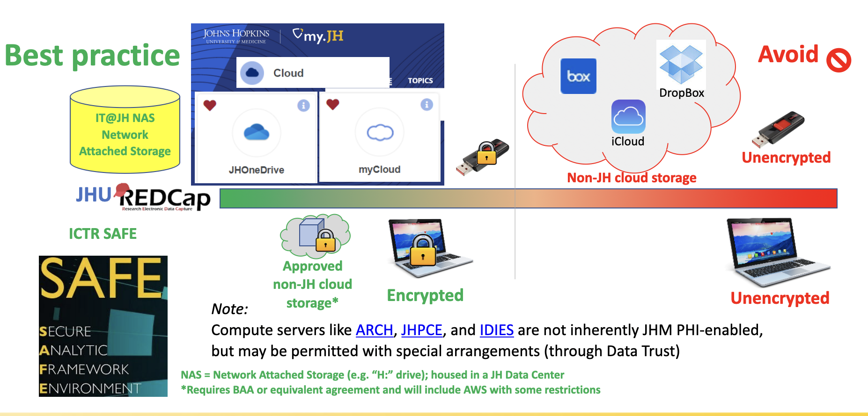
Data security landscape

Slide 12
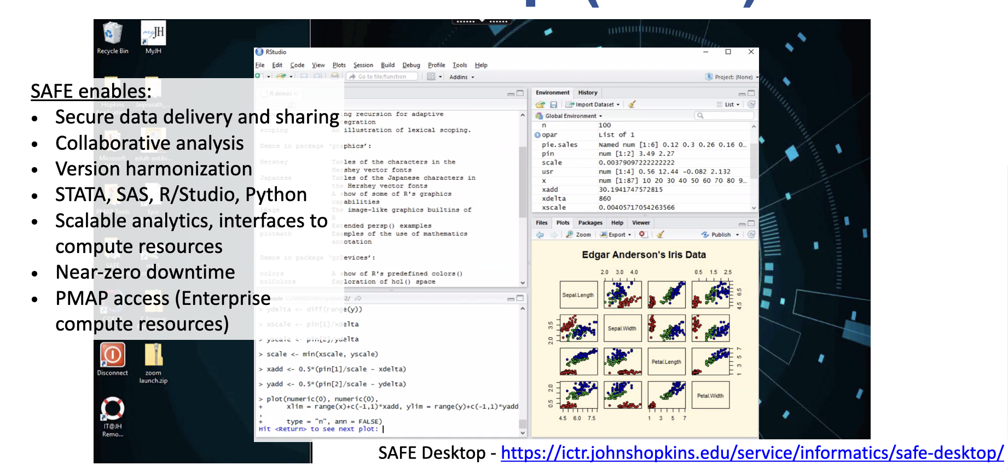
JH SAFE Desktop

Slide 13
Things to avoid
Don’t: Image patients using native phone app
  Do: Use Haiku (for record) or Corus (for sharing)
Don’t: Store of work-related data using non-JH cloud services
  No work use of DropBox, Box, Google Drive, iCloud
  Allowed: ^{JH}OneDrive, ^{JH}Teams, ^{JH}Sharepoint
Don’t: Store data/presentations on unencrypted USB drives etc
  Do: Use ^{JH}OneDrive and other best practice resources already listed
Never: Share JHED credentials with others

Slide 14
Scholarship

Slide 15
Potential for rigor
Data driven research has great potential to be:
  Replicable
  Reproducible
  Reusable

Slide 16
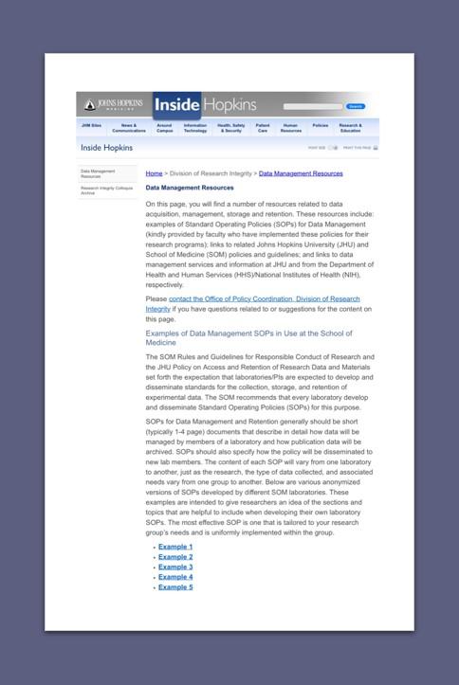
Data hygiene is foundational
Data ecosystem is increasingly complex
The more templated our systems are, the easier it is for faculty and trainees to do the right thing
Helpful resources
  https://intranet.insidehopkinsmedicine.org/division-of-research-integrity/data-management-resources/index.html
Slide courtesy of Antony Rosen

Slide 17
Research reproducibility recommendations
Identify and share “best practices”
Expand educational opportunities and accessibility
Create an archive resource (archive@JHUSOM) that will serve as a repository for primary data that supports all publications

Slide 18
Research reproducibility recommendations
Assess data storage capacities and capabilities through departmental reviews and provide assistance in design and implementation of practical, adaptive and cost-effective solutions
Explore approaches for providing JHUSOM investigators with current information regarding the utility of experimental reagents

Slide 19
Expectations
Data provenance
  History of the data from creation to present, who/when/what changed
Research notebooks and data that can be:
  Linked to published works
  Annotated by all involved parties
Data storage SOPs

Slide 20
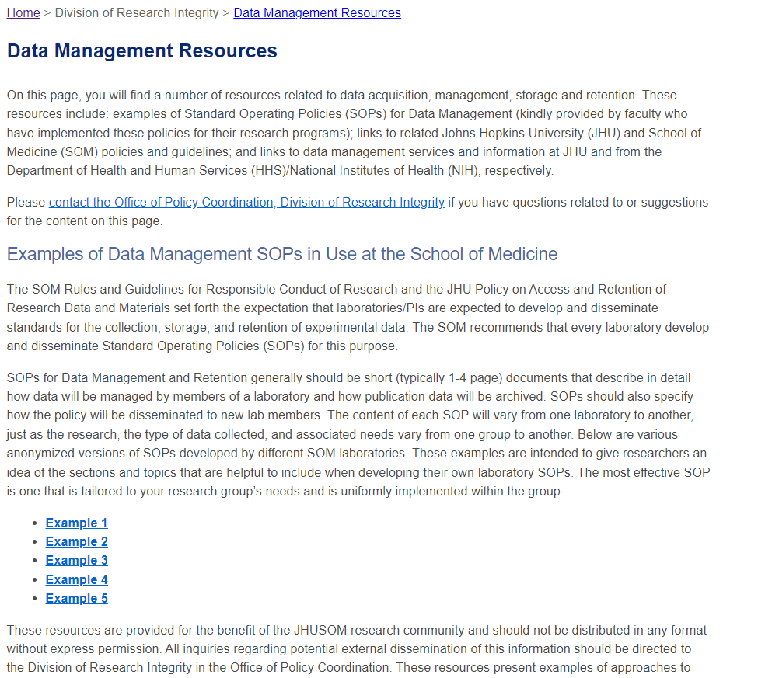
Data management SOPs
Making it easier
https://intranet.insidehopkinsmedicine.org/division-of-research-integrity/data-management-resources/index.html

Slide 21
Data management SOPs
Determine the Research Sponsor Requirements
Identify the Data to Be Collected
Define How the Data Will Be Organized
Explain How the Data Will Be Documented
Describe How Data Quality Will Be Assured
Present a Sound Data Storage and Preservation Strategy
Define the Project’s Data Policies
Describe How the Data Will Be Disseminated
Assign Roles and Responsibilities
Prepare a Realistic Budget

Slide 22
Continuity of data
When faculty/staff/trainees leave Johns Hopkins, these things must remain at JHU (unless arrangements are made in advance):
  research records
  (if applicable) clinical data registries
  computers/other equipment using JHU funds

Slide 23
Continuity of data
After faculty/staff/trainees leave Johns Hopkins, how will data be accessed to complete unfinished work?
For IRB-governed research, changes in employment/enrollment status must be reflected in IRB Change in Research
Enabling view of data on a JH server (e.g. JH OneDrive) with someone outside JH is still sharing – even if the data doesn’t “physically” move.

Slide 24
Awesome responsibility
Authorship
  Recognize, appropriately, contributions to science
Data stewardship
  Protect our research participants’ rights
  Shepherd the data life cycle from collection and analysis to retention and sharing
  Communicate the plan so that it is a shared understanding

Slide 25
Awesome responsibility
Ethical use
  “Data is the new oil” – a mantra in our world of big data
    Implications of this fraught metaphor
    Risks of repeating Henrietta Lacks’ experience if we’re not intentional about consent and equity
  Sharing data to the extent allowable

Slide 26
More information
Expanding menu of resources & navigation at https://researchit.jh.edu
Reach out to datatrust@jhmi.edu with questions, pre-review of submission documents, etc.

Slide 27

More Information
Expanding menu of resources & navigation at https://researchit.jh.edu
Reach out to datatrust@jhmi.edu or Stuart Ray sray@jhmi.edu with questions, pre-review of submission documents, etc.
For additional information about the Responsible Conduct of Research (RCR) program or any other questions, please contact the Office of Research Integrity at integrity@jhmi.edu or phone at (667) 208-8948.
For more information about training requirements for JHU faculty, trainees and staff engaged in research at the School of Medicine can be found at: RCR Program (hopkinsmedicine.org).

